Slide 1
Predict 30 - day hospital readmission for ICU patients through EHR
A data science and machine learning project

Slide 2
Table of contents
1
Problem introduction - my motivation to finds solutions
2
Algorithms and the problem solving process
3
Real code showing

Slide 3
Glossary of terms
01
EHR
02
Hospital readmission
03
ICU
Metrics
Unstructured data
04
05
06
Word vectorization
Electrical health records
When a patient who had been discharged is admitted again
Stands for Intensive Care Unit
Data that is not organized
Statistics to rate performance of a ML model
Converting words to number

Slide 4

01
Problem introduction

Slide 5
Hospital readmission problem
Signal of issues with healthcare quality, indicators of persisting issues in a patient’s health (Ponzoni et al., 2017):
Shows that hospitals did not utilize:
Patient education
Discharge assessments
In home after care options
over $17 billion of avoidable costs (2004)
12% to 75% of these readmissions could have been avoided (Benbassat & Taragin, 2000)

Slide 6
Electronic health records
Store health information:
Has the potential to improve hospital care and hospital workflow but are locked away
Here come the data scientists to discover the vault!

Slide 7
Previous attempt to learn from EHRs data
Relied only on structured data
Did not use deep learning widely
Some prior studies, even though built deep learning models, did not seem to spend enough time for tuning the hyperparameters
Data processing method isn’t shown on paper

Slide 8
Contributions of this project
evaluate the usefulness of unstructured data in EHRs for predicting ICU readmission rates
evaluate the effectiveness of data processing of the prediction models

Slide 9
02
Solutions and algorithm

Slide 10
Model definition
A classification model to predict which patients are at risk of for 30-day unplanned readmissions using free text hospital discharge

Slide 11
Dataset for experiments
MIMIC-III (MIT): de-identified data from over 50,000 patients who were admitted to Beth Israel Deaconess Medical Center in Boston, Massachusetts from 2001 to 2012
Diabetes 130-US hospitals for years 1999-2008 (UCI)

Slide 12
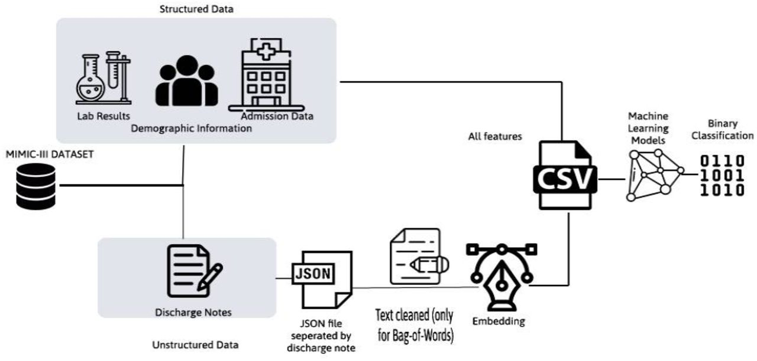

Slide 13
Models to experiment with:
K Nearest Neighbor
Logistic Regression
Stochastic Gradient Descent
Naive Bayes
Decision Tree Classifier
Random Forest
Feed Forward Network with ReLU activation, LR (sigmoid) hidden layer, and Adam optimizer
===> The winner is: Logistic Regression

Slide 14
Step 1: Prepare data
Load data
Tackle imbalanced data problem, 3 main ways:
sub-sampling the negatives
Over-sampling the positives
Create synthetic data
Prepare train, valid and test sets
Note: imbalanced data is common in data science

Slide 15
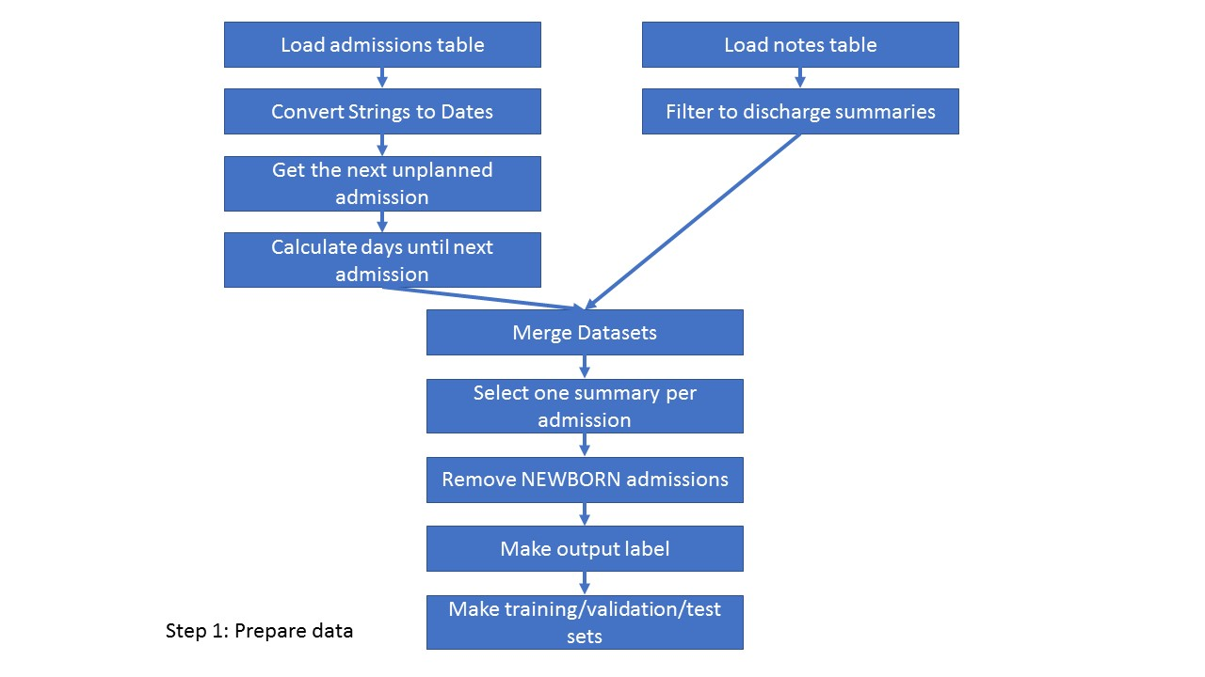

Slide 16
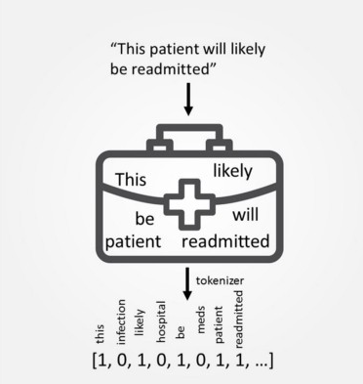
Step 2: Preprocess unstructured data
Convert text data to something meaningful
Choices to be made:
How to pre-process the words
How to count the words
Which words to use
Bag-Of-Words approach: very fancy
Use word_tokenize function form nltk pack
Use CountVectorizer from scikitlearn,
TfidfVector gives similar result

Slide 17
Step 3: Use simple predictive model
Logistic Regression is a good baseline model
Change regularization parameter C to prevent overfitting

Slide 18
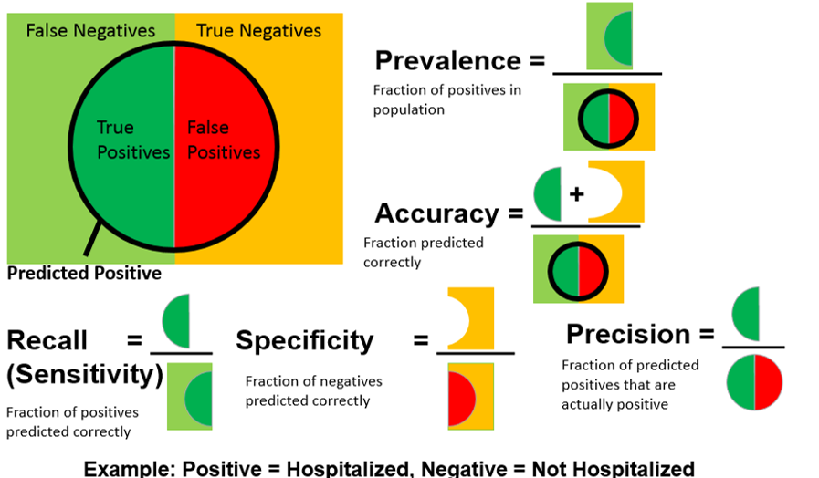
Step 4: Assess model - performance metrics

Slide 19
Step 5: Improve model
Answers the following questions:
should we spend time getting more data?
how to tokenize — should we use stemming?
how to vectorize — should we change the number of words?
how to regularized the logistic regression — should we change C or penalty?
which model to use?

Slide 20
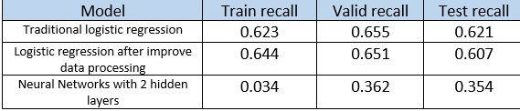
Results:

Slide 21
03
Showing the ‘real’ code

Slide 22
04
Further reading and references

Slide 23
Readings
https://www.medrxiv.org/content/10.1101/2021.08.10.21261858v1.full
How to solve 90 of NLP problems:
https://blog.insightdatascience.com/how-to-solve-90-of-nlp-problems-a-step-by-step-guide-fda605278e4e
https://en.wikipedia.org/wiki/Tf%E2%80%93idf
https://arxiv.org/pdf/1808.04928.pdf
https://www.nature.com/articles/s41598-019-39071-y
https://arxiv.org/pdf/1904.05342.pdf
https://github.com/thuytrangnugget/Deep-EHR-learning-and-prediction

Slide 24


